Slide 1
Phishing URL Detection
Using Machine Learning
Classification
Kalpan Pankajbhai Shah
Shaikh Basim Mushtaque Ahmed
Navaneeth Maruthi

Slide 2
1
Introduction
1.1
Problem Definition and Importance
Attack Statistics
Due to users' preferences shifting from traditional shopping to electronic commerce, Phishing attacks continue to pose a major threat for computer system defenders, often forming the first step in a multi-stage attack. Instead of robbing banks or shops, thieves now use sophisticated techniques to locate victims online. Attackers trick victims into visiting fake websites to steal private information, including passwords, usernames, and account IDs.
Phishing Emails
3.4B/day
Success Rate
30%
Financial Loss
$54M/year
Project Objective
Develop a machine learning classification model that predicts if a website is phishing or legitimate using URL characteristics.
Why Machine Learning?
Improve cybersecurity defenses
• Adapt to evolving attack patterns
• Learn from large datasets
Protect users from fraud and identity theft
• Identify subtle patterns
Enable real-time URL verification
• Enable real-time detection

Slide 3
1.2
Applications & Challenges
Applications
Challenges
Web Browsers
1
Visual Similarity
Built-in feature for real-time URL verification before page load
Phishing URLs often look very similar to legitimate ones, using domain variations like paypa1.com vs paypal.com
Email Filtering
Integration into email systems to filter phishing links
2
Rapid Evolution
Cybersecurity Tools
Attackers frequently create new phishing websites, making it challenging to maintain accurate and up-to-date detection systems
Enterprise security solutions and endpoint protection
Standalone Website
3
Semantic Complexity
User-accessible platform for URL verification
Semantics-based attack structures make it extremely difficult to determine webpage authenticity using simple rule-based approaches

Slide 4
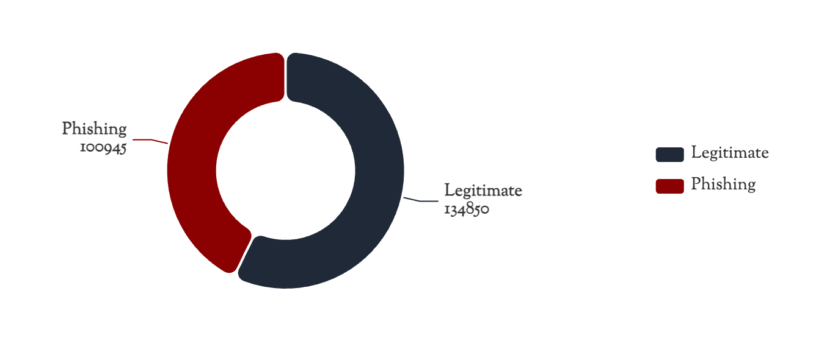
2.1
Dataset Description
Dataset Source
Class Distribution
PhiUSIIL Phishing URL
UCI Machine Learning Repository
Dataset Characteristics
Total Samples
235,795
Legitimate URLs
134,850
Phishing URLs
100,945
Feature Sources
Data Quality
URL string characteristics + Web page source code analysis
No missing values - complete dataset ready for training

Slide 5
2.2
Feature Information & Preprocessing
Total Features
Status
Data Types
54
Pre-extracted
Mixed
per sample
No further extraction needed
Integers, Floats, Categories
Feature Categories
Data Preprocessing
URL-based Features
1
Drop Non-informative Columns
URLLength
DomainLength
IsDomainIP
TLD
URLSimilarityIndex
URLCharProb
2
Encode Categorical Variables
Content-based Features
One-hot encoding or label encoding for TLD and domain
CharContinuationRate
TLDLegitimateProb
URLTitleMatchScore
3
Normalize/Standardize
Scale continuous variables for distance-sensitive models
Data Quality: No missing values - dataset is complete and ready for preprocessing
4
Handle Class Imbalance
Optional SMOTE for balancing classes

Slide 6
2.3
Problem Formulation
Binary Classification Problem
Supervised Machine Learning Approach
Input
Output
URL + Web Page Features
Binary Classification Result
1
Legitimate
0
Phishing
Methodology
Train multiple supervised ML classifiers
Compare performance metrics
Identify most effective model
Class 1
Class 0
Optimize for real-world deployment
Safe, authentic websites
Malicious, fraudulent websites

Slide 7
2.4
Machine Learning Models
Logistic Regression
Random Forest
Baseline Model
Ensemble Method
Type
Type
Linear classifier for binary classification
Tree-based ensemble using bagging
Purpose
Purpose
Establish baseline performance for comparison
Handle non-linear relationships and feature interactions
Strengths
Strengths
Interpretable, fast training, probabilistic output
Robust to overfitting, feature importance, handles mixed data
XGBoost
Deep Neural Network
Gradient Boosting
Deep Learning
Type
Type
Extreme Gradient Boosting ensemble
Multi-layer neural network architecture
Purpose
Purpose
Optimize prediction accuracy with regularization
Capture complex non-linear relationships
Strengths
Expected
High performance, handles imbalanced data, efficient
Superior performance on complex patterns
Superior performance on complex patterns

Slide 8
2.5
Evaluation Metrics & Expected Outcome
Accuracy
Precision
Recall
F1-Score
AUC-ROC
Overall
Exactness
Coverage
Harmonic
Threshold
Evaluation Metrics
Expected Outcome
Accuracy
Overall correctness
Target Performance
Proportion of correctly classified URLs (both legitimate and phishing)
F1 > 0.95
Precision
Exactness measure
Ratio of true positives to total predicted positives
High-performing classifier capable of reliably distinguishing phishing from legitimate URLs
Recall
Critical
Ratio of true positives to actual positives - minimize false negatives
Deployment Ready
F1-Score
Balanced measure
Browser Extensions
Harmonic mean of precision and recall
Real-time URL verification
AUC-ROC
Threshold analysis
Email Filtering
Area under ROC curve for threshold-independent evaluation
Automated phishing link detection
Security Tools
Enterprise cybersecurity solutions

